Slide 1
Woodlands Assessment & Target-Setting 2019-20

Slide 2
Philosophy Behind Assessment at Woodlands School
Assessment must be bespoke, relevant, streamlined and accessible.
Assessment must enable learning and progression.
Empowering learning is a multi-faceted process; data is only one facet.
Pupils may follow different curricular flight-paths at different times, or require a flexible curricular combination.
It is achievement that matters, not attainment.
Assessment schemes may be linear, or they may provide a lateral “patchwork quilt”.
The curriculum must be diverse and holistic, and so must assessment.

Slide 3
New Assessment Framework: A Brief History!
Old Curriculum:
New Curriculum:
“Life Without Levels”: Woodlands Steps
P Levels (P1i – P8)
Gap
Old National Curriculum (L1c – L8)
P Levels (P1i – P8)
Gap got Bigger!
New National Curriculum
One continuum (W1i – W18) - bridging the Gap

Slide 4
Woodlands Assessment Equivalence Chart (an in-exact science)

Slide 5
Curricular Assessment: Solar
Subject | Strands | Range | Overall Weighting
Literacy | Writing 2) Reading 3) Communication, Vocabulary, Grammar and Punctuation | W4 – W18 | 33% per strand
Numeracy | Using, Applying, Statistics 2) Shape 3) Number | W4 – W18 | 33% per strand
Science | Enquiry | W4 – W18 | 100% per strand
Computing | N/A | W4 – W18 | 100%
S.M.S.C. | N/A | W4 – W18 | 100%
Lower P (PMLD) | Communication | W1i – W3ii | 100%

Slide 6
“Stage, not age”
P1 P2 P3 P4 P5
“Empower”: Sensory
Curriculum
“Enrich”: Semi-formal Curriculum
“Employ”: Formal Curriculum
W13 W14 W15 W16 W17 W18
W9 W10 W11 W12
1 2 3 4 5 6 7 8 9
Steps
W1 W2 W3 W4 W5 W6 W7 W8
GCSE
E1 E2 E3
1
2
Entry Level
Level 1/2 Qualifications

Slide 7
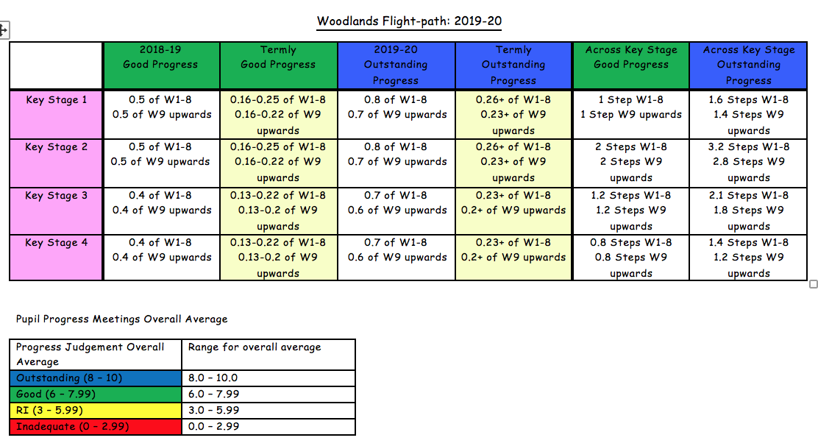
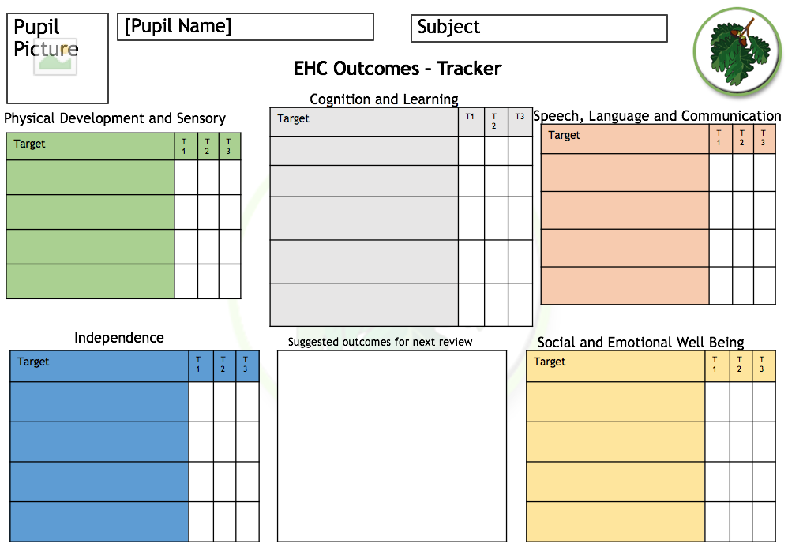
Methods of Assessment & Target Setting
SOLAR: W Steps
Marking, annotation & feedback
Work/photos/videos that evidence progress over time
Feedback from Area Reviews
Audits (eg Communication Friendly Environment)
Pupil Voice interviews and questionnaires
Progress Meetings & Accelerated Progress Interventions
Reading & Phonics Assessments – eg Letters & Sounds Phonics Programme, BURTS, Derbyshire
Therapy assessments – eg Hydro Therapy, SDQs Strengths & Difficulties Questionnaire)/Boxall Profile/Thrive assessment, Rebound Therapy, Sherbourne, Eye Gaze, Speech & Language Therapy
Attendance (SIMS) & Behaviour (Behaviour Watch)
Development Matters (Early Years Steps) – incorporated into SOLAR
EHCP Trackers
BKSB/Vista – under further development
Accreditation – attainment
Soft Skills (identified within SOLAR)
Aspects of Engagement
MSI (Multi Sensory Impairment)
SCERTS (Social Communication Emotional Regulation & Transactional Support)
Internal and external moderation
TRACK: tracks progress against at least Good progress for W Steps
Provision Matrix: collates progress, attendance and therapies data
Woodlands Flight Path: in-year progress and across-Key-Stage progress

Slide 8
Accreditation Evolution & Pathways
Woodlands School Accredited Outcomes 2015 - 2020
KS4:
Entry Level English
Entry Level Maths
Entry Level PE
Entry Level Science
IGCSE English
KS5:
E1-3 OCNW/MR Skills for work and life
Functional Skills Maths
Functional Skills English
Functional Skills ICT
Arts Award
ASDAN E3 Award Practical Cooking Skills
KS4:
P1-8 ASDAN Transition Challenge
Entry Level English
Entry Level Maths
Entry Level PE
IGCSE English
WJEC E2-3 Preparing for work
WJEC E2-3 Science Today
WJEC E2-3 IT Users
KS5:
P1-8 ASDAN Towards Independence
E1-3 OCNWMR Skills for Work and Life
ASDAN PSD
Functional Skills Maths
Functional Skills English
Functional Skills ICT
KS4:
P1-8 ASDAN Transition Challenge
Entry Level English
Entry Level Maths
Entry Level PE
IGCSE English
WJEC E2-3 Preparing for work
WJEC E2-3 Science Today
WJEC E2-3 IT Users
WJEC E2-3 Independent Living
WJEC E2-3 Humanities
KS5:
P1-8 ASDAN Towards Independence
ASDAN Workright
ASDAN E2-L2 Employability
E1-3 OCNWMR Skills for Work and Life
ASDAN PSD
Functional Skills Maths
Functional Skills English
Functional Skills ICT
BTEC E3-L2 Work Skills
KS4:
P1-8 ASDAN Transition Challenge (Pre – entry level)
Entry Level English (E1 – E3)
Entry Level Maths (E1 – E3)
Entry Level PE (E1 – E3)
IGCSE English
WJEC (E2 – E3) Preparing for work
WJEC (E2 – E3) Science Today
WJEC (E2 – E3) IT Users
WJEC (E2 – E3 )Independent Living
WJEC (E2 – E3) Humanities
Duke of Edinburgh Award (Bronze)
KS5:
ASDAN Towards Independence (Pre-entry level)
ASDAN Workright (Pre-entry level)
ASDAN Employability (E2-L1)
ASDAN Personal Social Development (E1-L1)
Functional Skills English (E1-L1)
Functional Skills Maths (E1-L1)
Functional Skills ICT (E1-L1)
OCNWMR Food Hygienic Certificate (E3-L1)
Duke of Edinburgh Award (Bronze)
BTEC Work Skills (E3-L1)
KS4/5
Functional Skills English (E1-L1)
IGCSE English
Entry Level English (E1-E3)
Entry Level Maths (E1-E3)
Functional Skills Maths (E1-L1)
Entry Level PE (E1-E3)
ASDAN Towards independence (pre-entry level)
ASDAN Workright (pre-entry level)
ASDAN Employability (E2-L1)
ASDAN Personal Social Development (E1-L1)
Functional Skills ICT (E1-L1)
OCNWMR Food Hygienic Certificate (E3-L1)
Duke of Edinburgh Award (Bronze)
BTEC Work Skills
P1-8 ASDAN Transition Challenge (pre-entry level)
2015 - 2016
2016 - 2017
2017 - 2018
2018 - 2019
2019 –
20

Slide 9
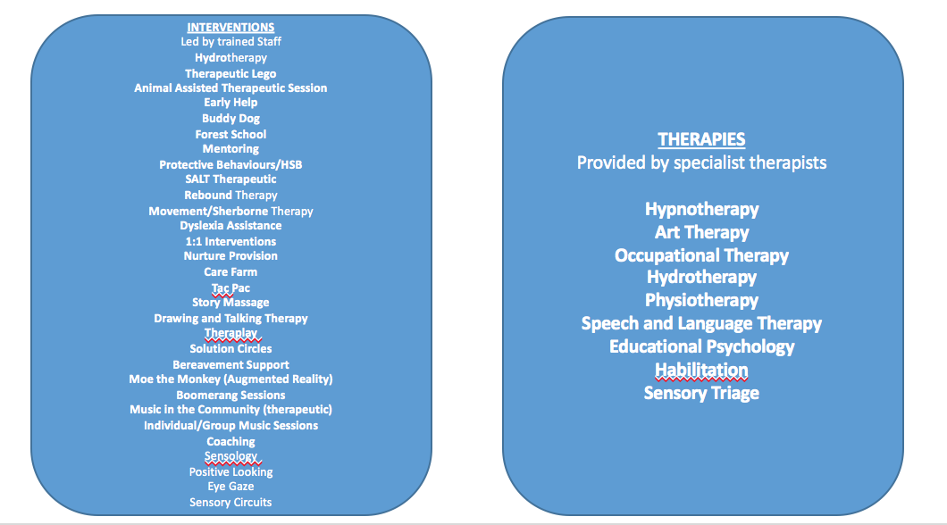
Curriculum and Therapies/Interventions

Slide 10
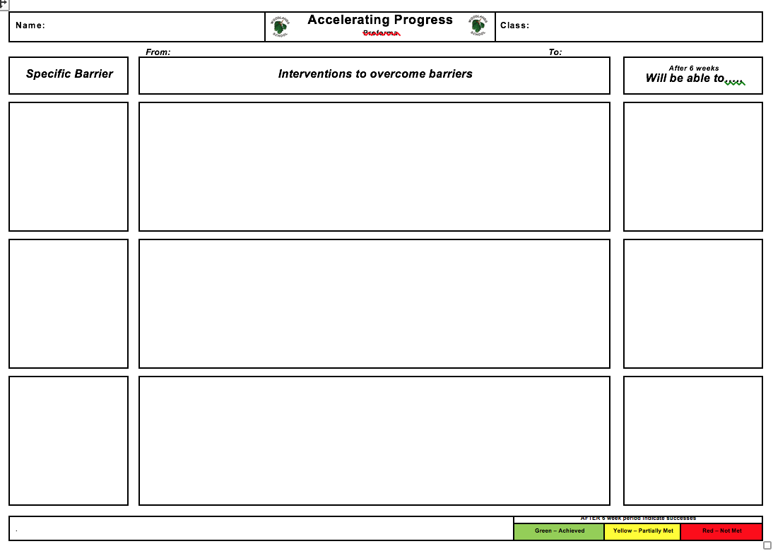
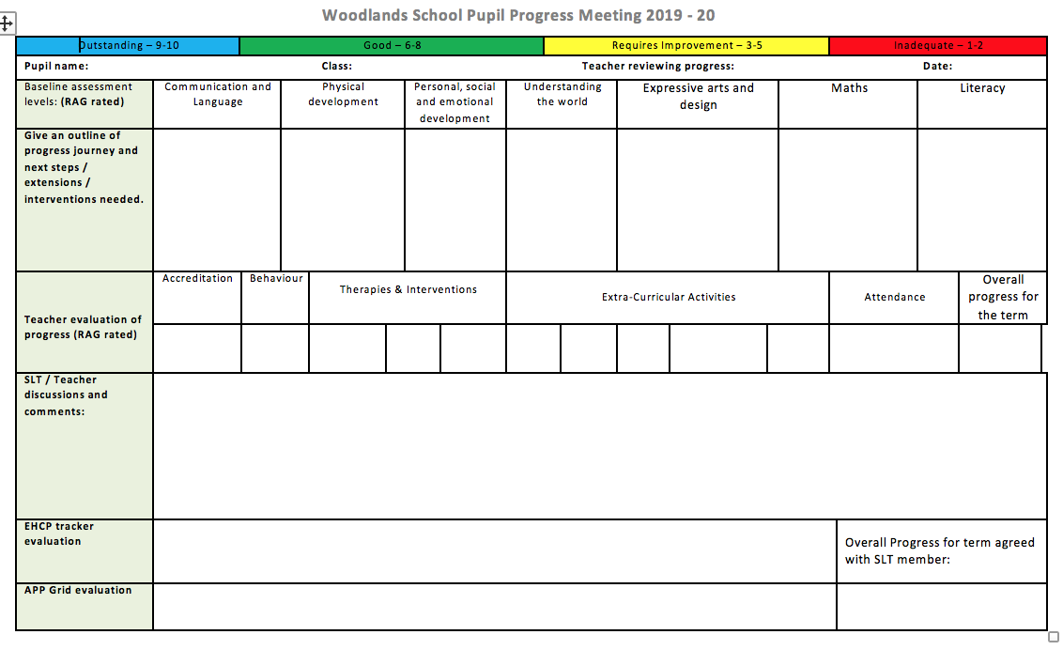
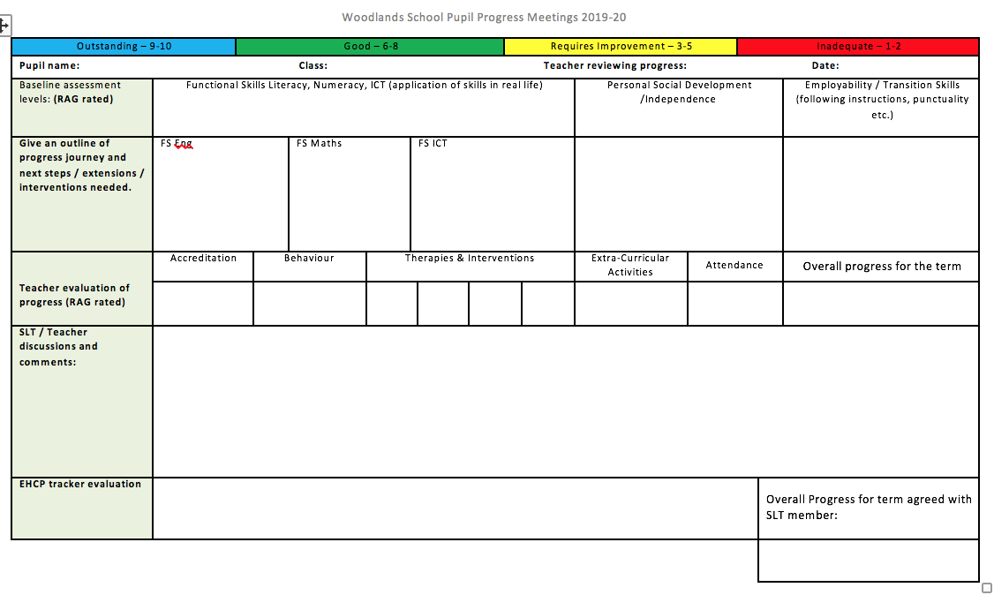
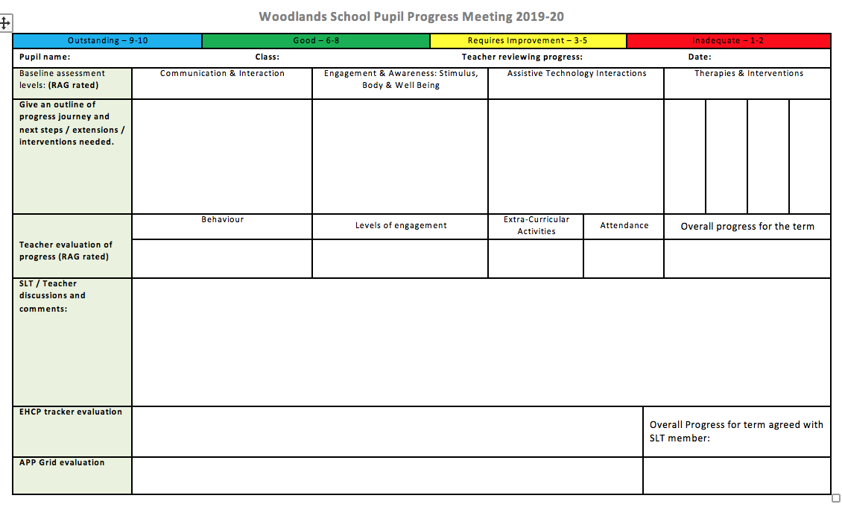
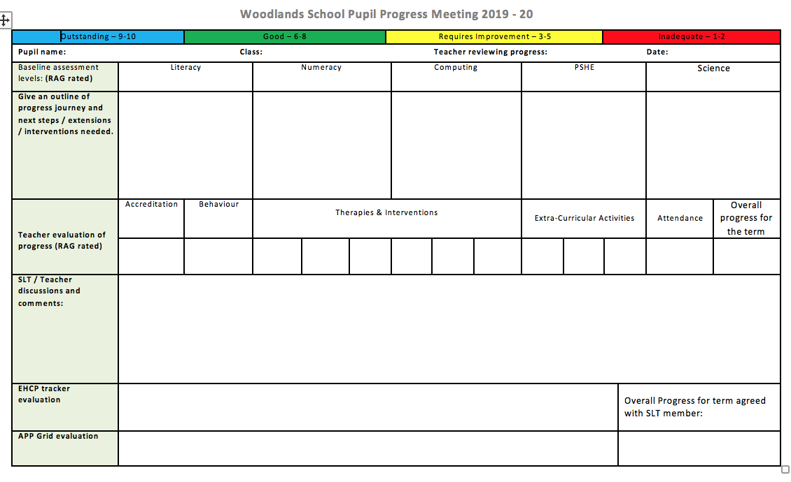
Pupil Progress Meetings 2019-20: Bespoke Frameworks; dialogue for celebration & improvement

